Slide 1
Git and github
SEMINAR
By Karl MUSINGO

Slide 2

Git vs GitHub
GitHub is a web based hosting service for Git repositories
Git is a Version Control System

Slide 3
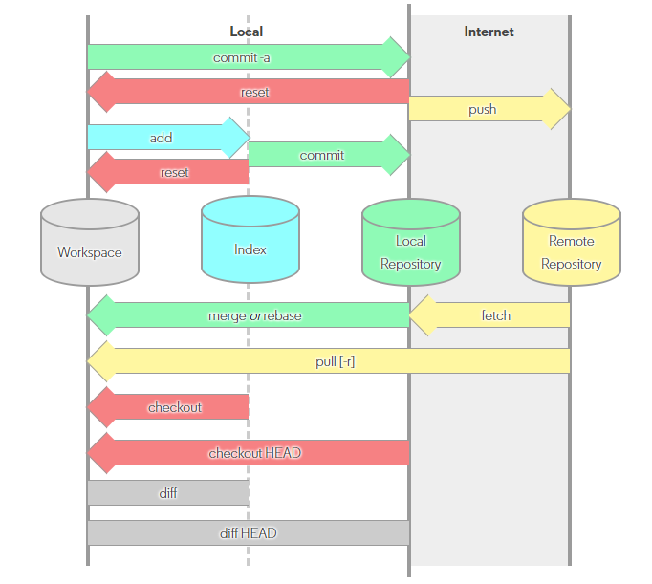
Local and Remote

Slide 4
What Git can do

Slide 5
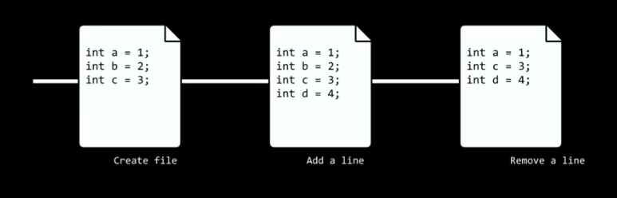
What Git can do
Keep track of changes to code

Slide 6






What Git can do
Synchronize code between different people

Slide 7
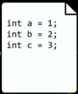
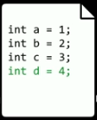
What Git can do
Test changes to code without losing the original

Slide 8
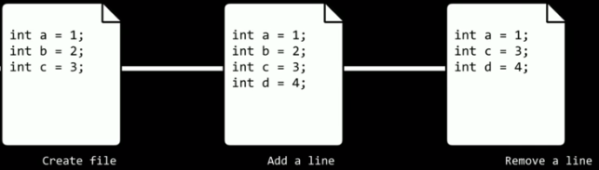
What Git can do
Revert back to old versions of code

Slide 9
What Git can do
Keep track of changes to code
Synchronize code between different people
Test changes to code without losing the original
Revert back to old versions of code

Slide 10
Git Clone

Slide 11
Git clone
Syntax: git clone <git url>
Makes a copy of a repository and stores it on your computer
‘git fork’ creates your own copy of someone else’s repository which also lives online

Slide 12
Git add

Slide 13
Git add
Syntax: git add <file name>/./--all/-a
git add index.html
git add .
git add -- all
git add – A

Slide 14
Git commit

Slide 15
Git commit
Syntax : git commit –m ‘ message‘
Saves the changes to repository as a new revision
git commit –am ‘message’ : adds and commits in one step

Slide 16
Git status

Slide 17
git status
Shows current status of the repository

Slide 18
Git push

Slide 19
Git push
Syntax : git push
Sends committed changes to the remote repository on github

Slide 20
Git pull

Slide 21
Git pull
Syntax: git pull
Retreive changes from remote repository

Slide 22
Merge conflict

Slide 23
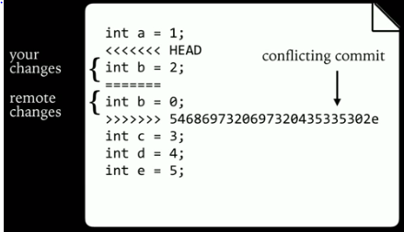
Merge conflict
When two different merge can’t be automatically merged
Occures when doing ‘git pull’ or ‘git merge’

Slide 24
Git log

Slide 25
Git log
Shows the history of commit and their messages

Slide 26
Git reset

Slide 27
Git reset
Syntax: git reset - - hard <commit>
reverts code back to a previous commit
Syntax: git reset - - hard origin/master
reverts code back to remote repository version

Slide 28
Branching

Slide 29
Branching
Branch is a version of the repository
Each branch has its own commit history and a current version
git branch
git checkout
git merge

Slide 30
Git branch
Syntax: git branch
shows all branches in the repository
Syntax: git branch <branch name>
creates a new branch
Syntax: git branch –D <branch name>
delete a branch

Slide 31
Git checkout
Syntax: git checkout <branch name>
switch to a new branch
Syntax: git checkout –b <branch name>
create a new branch and switch to it in one step

Slide 32
Git merge
Syntax: git merge <branch_name>
merges the branch_name with the current branch

Slide 33
Pull Requests

Slide 34
Thank you…

